Slide 1


Autonomous Shopping Cart
Innovative Retail Assistance Using AI, Robotics, and IoT
Shoubra Faculty of Engineering – Benha University
Department of Communications and Computer

Slide 2
OUR TEAM
Paula Ayman Mikhael
Paula Emad Shohdy
Michael Samy Habashy
Muhammad Usama Aowad
Mohamed Osama Mohamed
Youssef Osman Fadel
1
Introduction
2
Application
3
Ros &
Kinematics
4
Mapping &
Navigation
5
Person
Tracking
6
Product
Recognition
7
Wireless
Comm
CONTENT
Ebram Maher Girgis
Supervised by:
Dr. Maher Abd El Rasoul
Dr. Mohamed Rehan

Slide 3
1
Introduction
2
Application
3
Ros &
Kinematics
4
Mapping &
Navigation
5
Person
Tracking
6
Product
Recognition
7
Wireless
Comm
CONTENT

Slide 4

Introduction
Shopping shouldn’t be a challenge - it should be smart.
1
Introduction
Retail has seen many innovations, but the shopping cart has barely changed in decades.
We present a smart, autonomous shopping cart that assists users, reduces effort, and enhances the retail experience using:
Artificial Intelligence
Computer Vision
Robotics and IoT
2
Application
3
Ros &
Kinematics
4
Mapping &
Navigation
5
Person
Tracking
6
Product
Recognition
7
Wireless
Comm
CONTENT

Slide 5
Introduction
The Problem
1
Introduction
Manual carts are inconvenient for:
Elderly users
People with disabilities
Parents managing children
2
Application
3
Ros &
Kinematics
4
Mapping &
Navigation
5
Person
Tracking
6
Product
Recognition
7
Wireless
Comm
CONTENT
Common frustrations:
Long checkout queues
Physical strain from pushing heavy loads
Traditional carts lack intelligence, automation, and integration with modern tech.

Slide 6
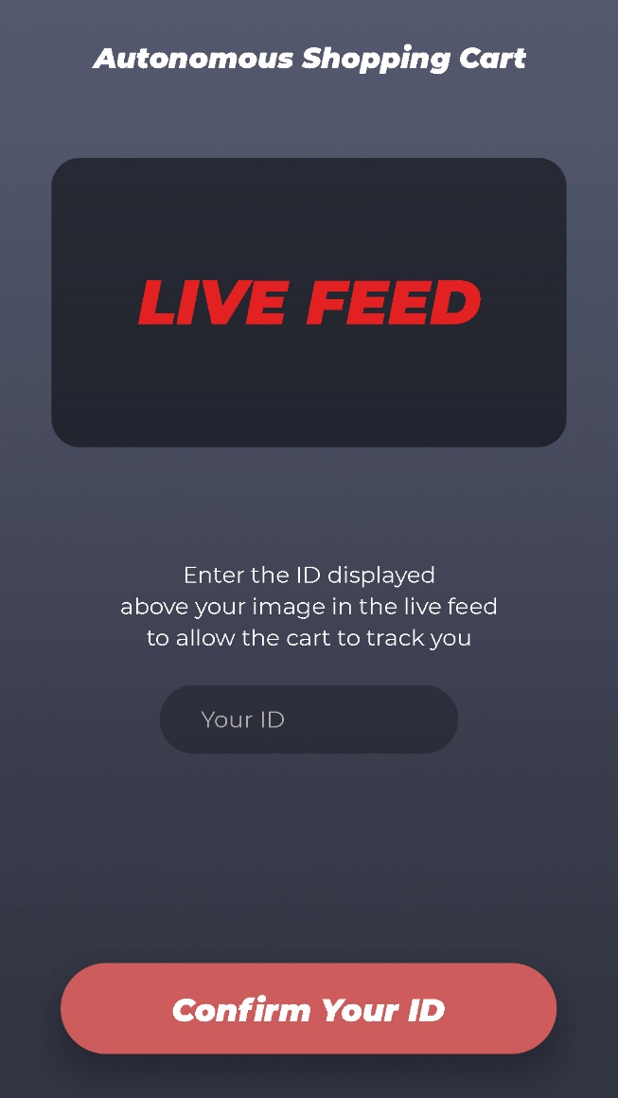
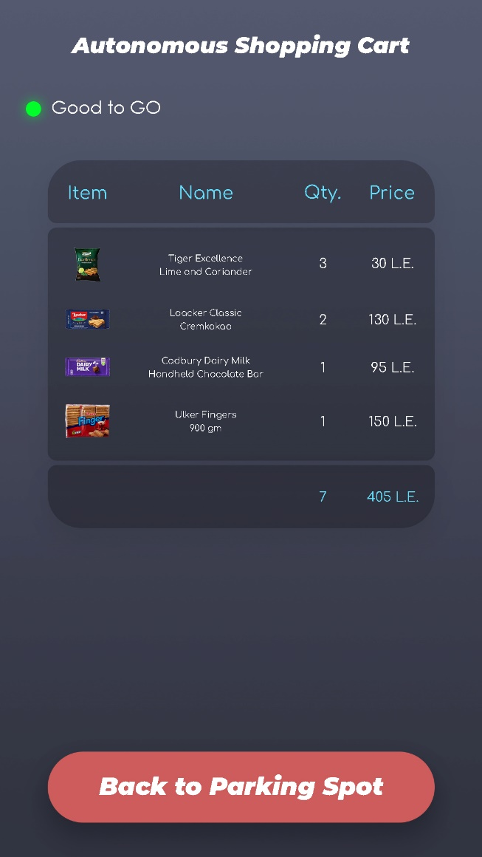
Introduction
Project Objectives
1
Introduction
Interactive with a mobile app.
2
Application
3
Ros &
Kinematics
4
Mapping &
Navigation
5
Person
Tracking
6
Product
Recognition
7
Wireless
Comm
CONTENT

Slide 7
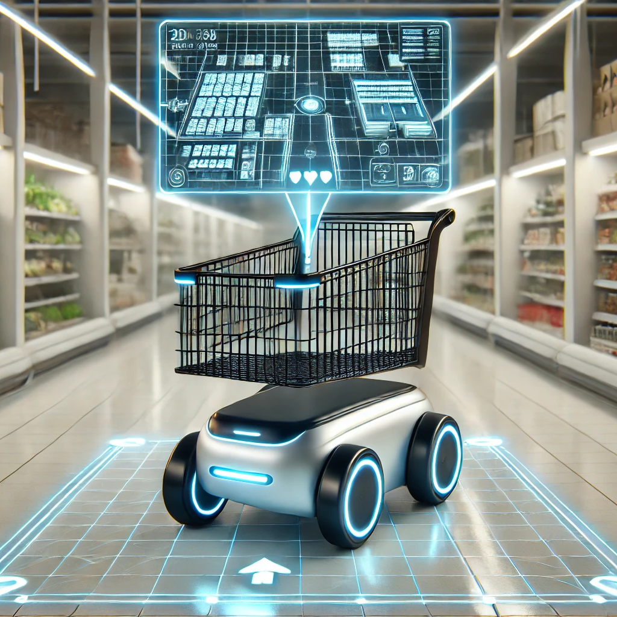
Introduction
Project Objectives
1
Introduction
Navigates within the store using map-based SLAM.
2
Application
3
Ros &
Kinematics
4
Mapping &
Navigation
5
Person
Tracking
6
Product
Recognition
7
Wireless
Comm
CONTENT

Slide 8
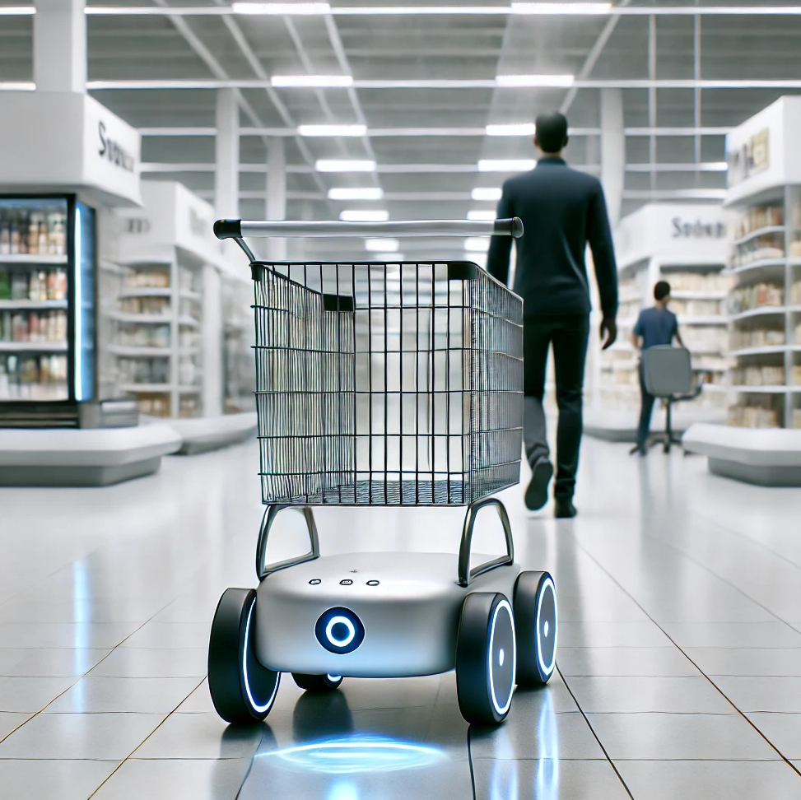
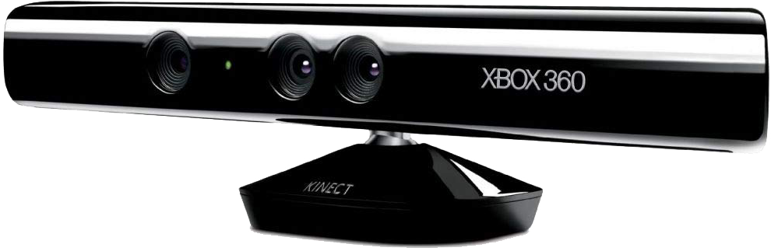
Introduction
Project Objectives
1
Introduction
Tracks and follows a specific user using Kinect + AI.
2
Application
3
Ros &
Kinematics
4
Mapping &
Navigation
5
Person
Tracking
6
Product
Recognition
7
Wireless
Comm
CONTENT

Slide 9
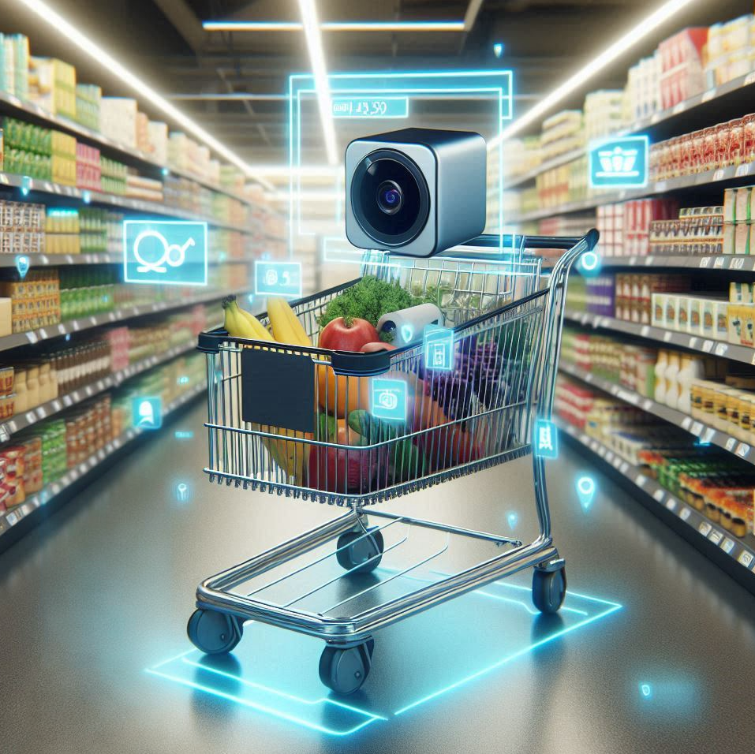
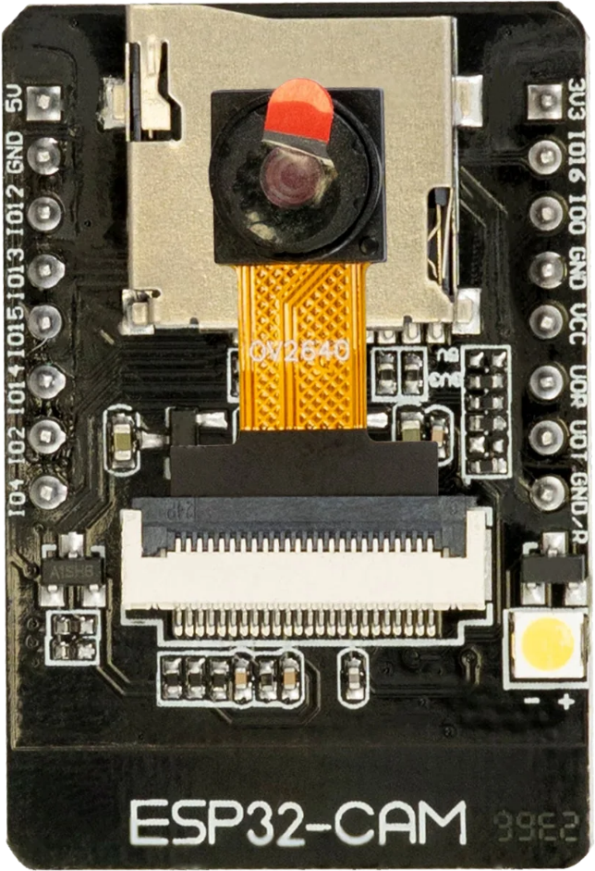
Introduction
Project Objectives
1
Introduction
Recognizes products in real-time using an AI model + ESP32-CAM.
Displays recognized items and prices on the user’s phone.
2
Application
3
Ros &
Kinematics
4
Mapping &
Navigation
5
Person
Tracking
6
Product
Recognition
7
Wireless
Comm
CONTENT

Slide 10
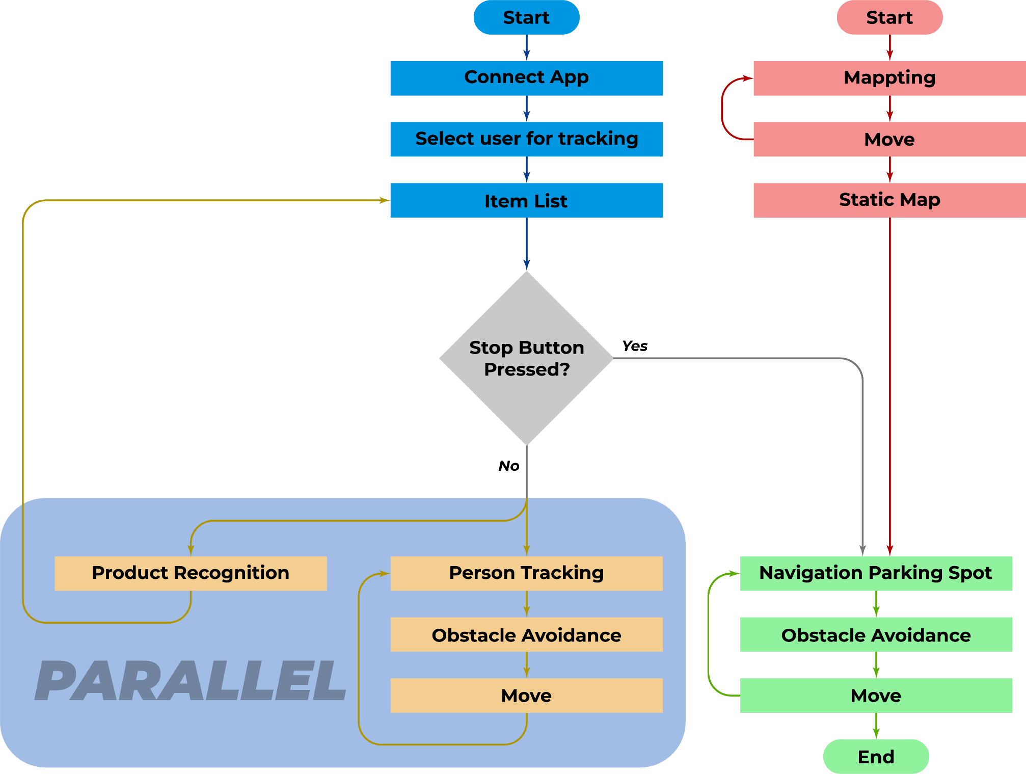
Introduction
System Flowchart
1
Introduction
2
Application
3
Ros &
Kinematics
4
Mapping &
Navigation
5
Person
Tracking
6
Product
Recognition
7
Wireless
Comm
CONTENT

Slide 11
1
Introduction
2
Application
3
Ros &
Kinematics
4
Mapping &
Navigation
5
Person
Tracking
6
Product
Recognition
7
Wireless
Comm
CONTENT

Slide 12

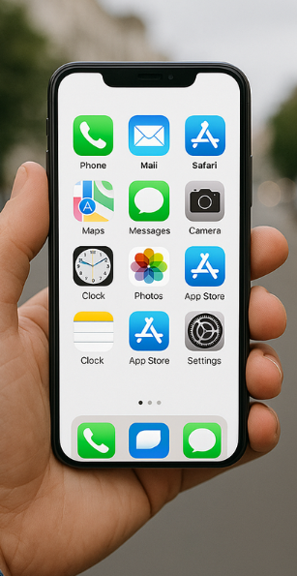



Mobile Application
Objectives
2
Application
User interface with cart
1
Introduction
3
Ros &
Kinematics
4
Mapping &
Navigation
5
Person
Tracking
6
Product
Recognition
7
Wireless
Comm
CONTENT
Show live stream from Kinect
Make user to write his ID
Show all the product in the cart

Slide 13
Mobile Application
Technologies Used
2
Application
To ensure smooth performance and cross-platform compatibility, the app was built using the Flutter framework and the Dart programming language. Communication with the hardware is handled through WebSocket for the live video stream and MQTT protocol for receiving product data from the recognition system. This architecture enables efficient real-time updates with minimal latency.
Flutter: for UI and cross-platform development.
Dart: programming logic.
WebSocket: for streaming live video.
MQTT: for receiving recognized product data and sending the ID.
Android Studio: for building and testing the application.
1
Introduction
3
Ros &
Kinematics
4
Mapping &
Navigation
5
Person
Tracking
6
Product
Recognition
7
Wireless
Comm
CONTENT

Slide 14
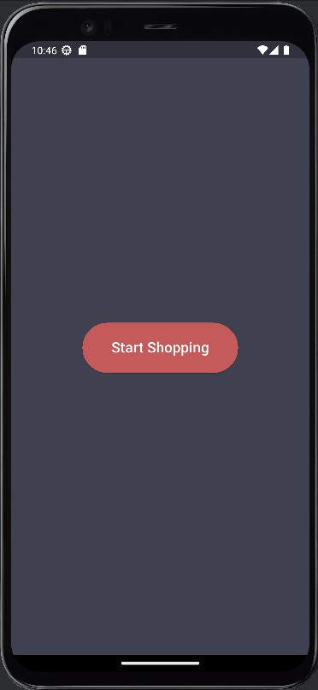

Mobile Application
Home Screen
2
Application
Functionality:
1
Introduction
3
Ros &
Kinematics
4
Mapping &
Navigation
5
Person
Tracking
6
Product
Recognition
7
Wireless
Comm
CONTENT
Shown when the app opens.
A single button to activate and start the system.
Triggers connection to cart, sensors.

Slide 15
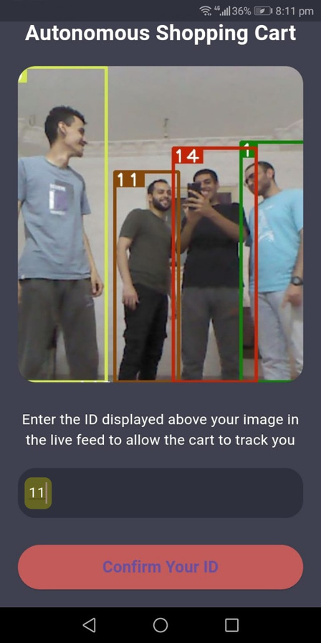
Mobile Application
Second Screen
2
Application
Functionality:
1
Introduction
3
Ros &
Kinematics
4
Mapping &
Navigation
5
Person
Tracking
6
Product
Recognition
7
Wireless
Comm
CONTENT
Shows live stream from Kinect camera.
User enters their ID in a text box.
Confirms the ID via a button.

Slide 16
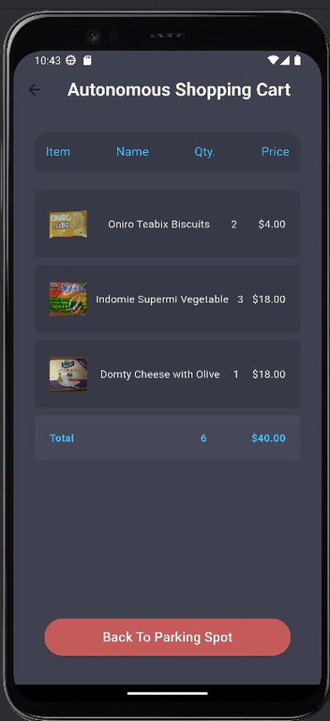
Mobile Application
Third Screen
2
Application
Functionality:
1
Introduction
3
Ros &
Kinematics
4
Mapping &
Navigation
5
Person
Tracking
6
Product
Recognition
7
Wireless
Comm
CONTENT
Shows all items added to the cart
Calculates total price and total item count
Allows removing items from the cart
Button to navigate cart to its parking spot

Slide 17
Mobile Application
Conclusion
2
Application
This app provides:
1
Introduction
3
Ros &
Kinematics
4
Mapping &
Navigation
5
Person
Tracking
6
Product
Recognition
7
Wireless
Comm
CONTENT
A modern retail experience
Reduced checkout lines
Enhanced user interaction

Slide 18
1
Introduction
2
Application
3
Ros &
Kinematics
4
Mapping &
Navigation
5
Person
Tracking
6
Product
Recognition
7
Wireless
Comm
CONTENT

Slide 19
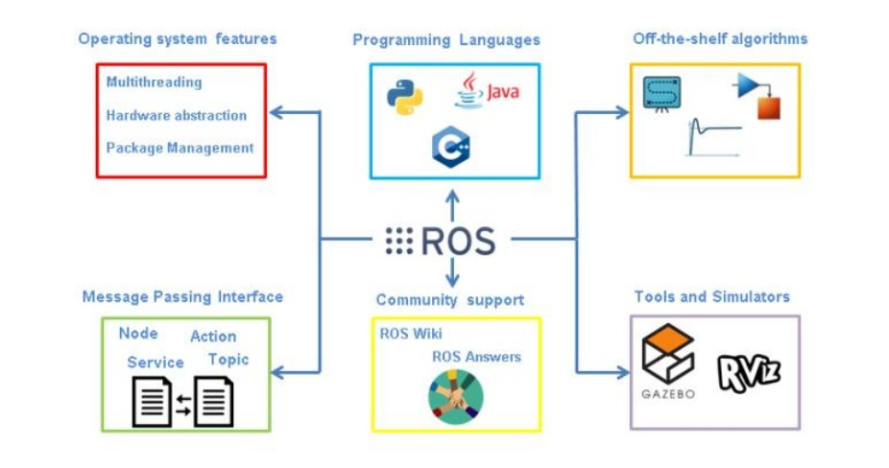
Ros
3
Ros &
Kinematics
1
Introduction
2
Application
4
Mapping &
Navigation
5
Person
Tracking
6
Product
Recognition
7
Wireless
Comm
CONTENT

Slide 20
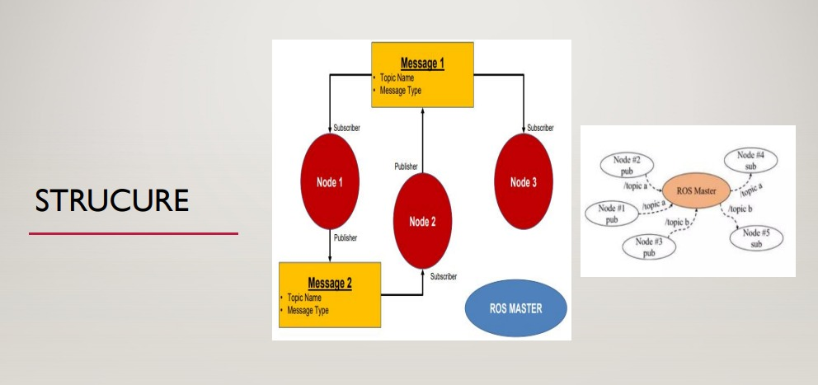
Ros
3
Ros &
Kinematics
1
Introduction
2
Application
4
Mapping &
Navigation
5
Person
Tracking
6
Product
Recognition
7
Wireless
Comm
CONTENT

Slide 21
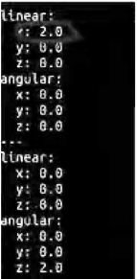
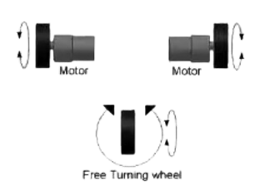
Kinematics
3
Ros &
Kinematics
As ROS is sending command velocity data in
(V , W)[unicycle model]
But in real robot we need speed command for left
and right wheel
(VL,VR)
1
Introduction
2
Application
4
Mapping &
Navigation
5
Person
Tracking
6
Product
Recognition
7
Wireless
Comm
CONTENT
so we need some equations to convert
(V, W) to (VL,VR)

Slide 22
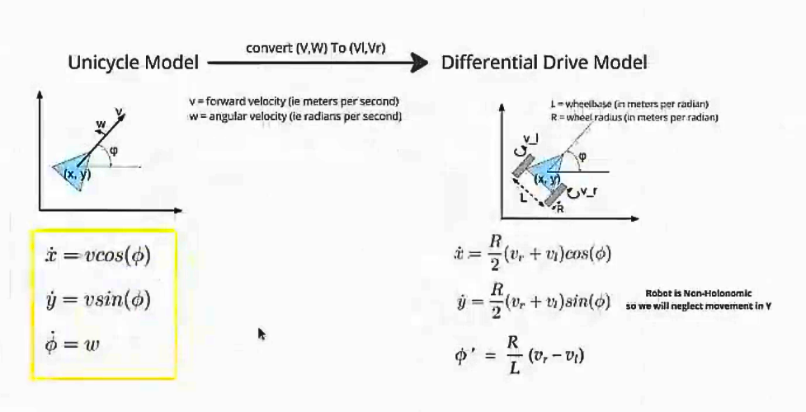
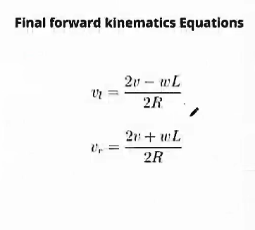
Kinematics
3
Ros &
Kinematics
1
Introduction
2
Application
4
Mapping &
Navigation
5
Person
Tracking
6
Product
Recognition
7
Wireless
Comm
CONTENT

Slide 23
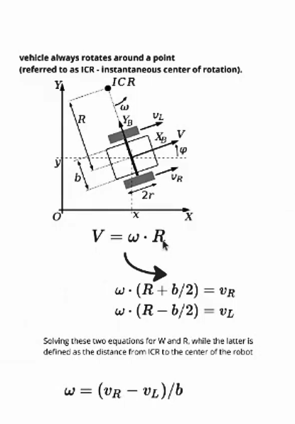
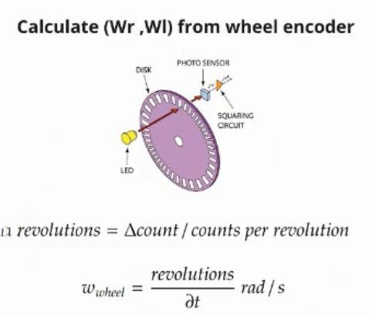
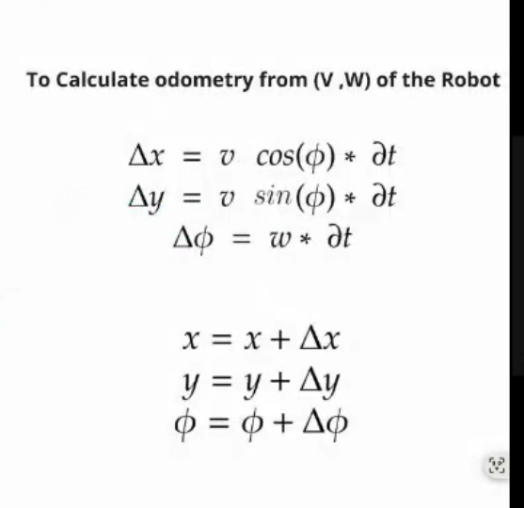
Kinematics
3
Ros &
Kinematics
Inverse kinematics of a differential robot
odometry: is x,y and theta position of the robot according to starting location
1
Introduction
2
Application
4
Mapping &
Navigation
5
Person
Tracking
6
Product
Recognition
7
Wireless
Comm
CONTENT

Slide 24
1
Introduction
2
Application
3
Ros &
Kinematics
4
Mapping &
Navigation
5
Person
Tracking
6
Product
Recognition
7
Wireless
Comm
CONTENT

Slide 25
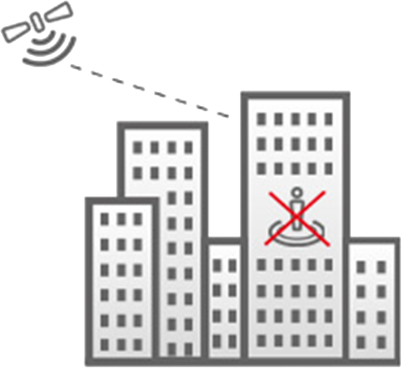
Mapping | Technique Selection
4
Mapping &
Navigation
Limitations of GPS in Indoor Environments
The primary reason is that GPS signals, which operate at high frequencies, struggle to penetrate dense materials like concrete, metal, and thick walls. These obstructions scatter or weaken the signals, resulting in poor or non-existent coverage inside buildings.
1
Introduction
2
Application
3
Ros &
Kinematics
5
Person
Tracking
6
Product
Recognition
7
Wireless
Comm
CONTENT
GPS accuracy (3-7 meters) is not enough for precise navigation between tight spaces.

Slide 26
Mapping | Technique Selection
4
Mapping &
Navigation
Our Solution
Feature | SLAM (Simultaneous Localization and Mapping) | IPS (Indoor Positioning System)
Accuracy | High (Up to 10 cm) | Varias (.5- 3 m)depends on technology (Wi-FI,BLE,UWB)
Infrastructure Required | No external setup needed | Required additional Setup (beacons).
Mapping Capability | Builds a real time map of the environment | Provides position only no mapping
Cost | Medium | Expensive
1
Introduction
2
Application
3
Ros &
Kinematics
5
Person
Tracking
6
Product
Recognition
7
Wireless
Comm
CONTENT

Slide 27
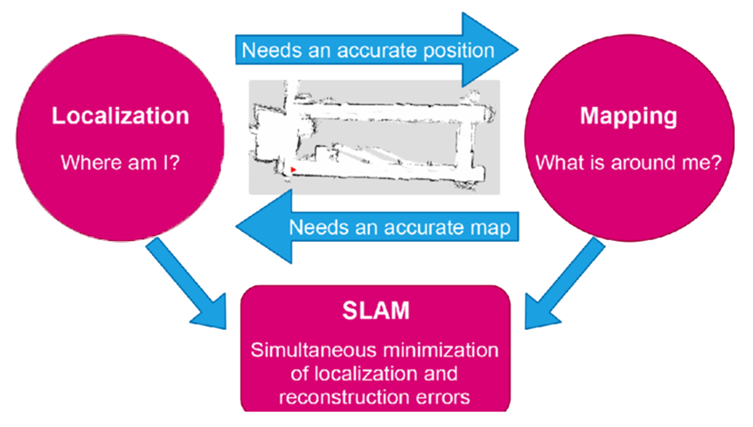
Mapping | Technique Selection
4
Mapping &
Navigation
SLAM
“SLAM” stands for Simultaneous Localization and Mapping. It's a technique used in robotics and computer vision to construct or update a map of an unknown environment while simultaneously keeping track of the robot's location within that environment.
1
Introduction
2
Application
3
Ros &
Kinematics
5
Person
Tracking
6
Product
Recognition
7
Wireless
Comm
CONTENT
SLAM problem arises when an autonomous system, such as a robot or a vehicle, needs to navigate and understand its environment in real-time.

Slide 28



Mapping | GMapping Algorithm
4
Mapping &
Navigation
Definition
Gmapping, which stands for Grid-based Mapping, is a popular algorithm for performing SLAM in robotics and autonomous systems.
1
Introduction
2
Application
3
Ros &
Kinematics
The Gmapping algorithm is based on particle filter and operates on laser scan data.
5
Person
Tracking
6
Product
Recognition
7
Wireless
Comm
CONTENT
It allows a robot to:
Build a 2D map of an unknown environment.
Track its position (Localization) while moving.

Slide 29
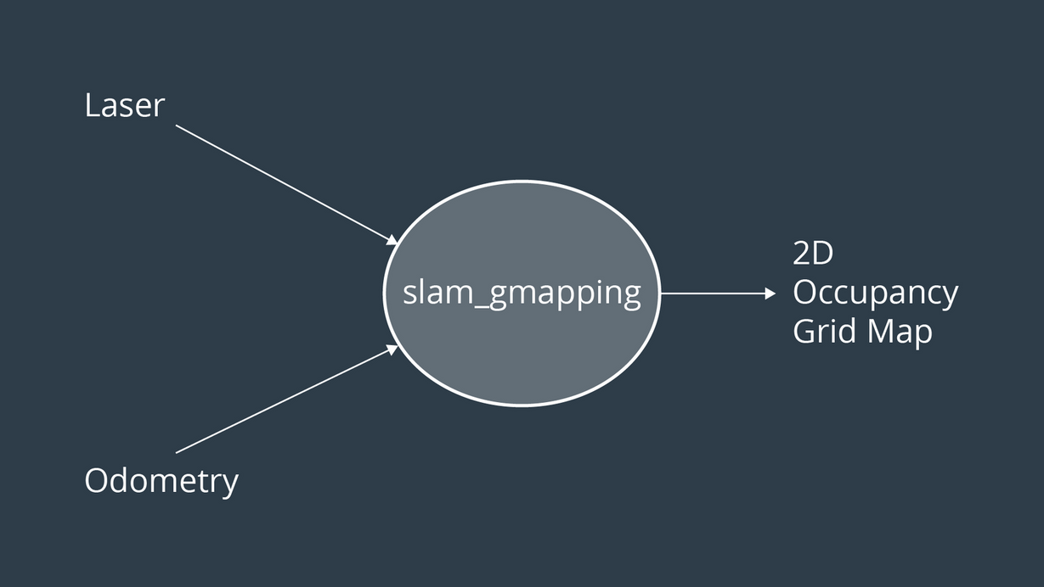
Mapping | GMapping Algorithm
4
Mapping &
Navigation
How It Works?
The robot move and collects laser scan data (from Kinect).
It combines this with odometry (wheel encoder readings).
1
Introduction
2
Application
3
Ros &
Kinematics
5
Person
Tracking
6
Product
Recognition
7
Wireless
Comm
CONTENT

Slide 30
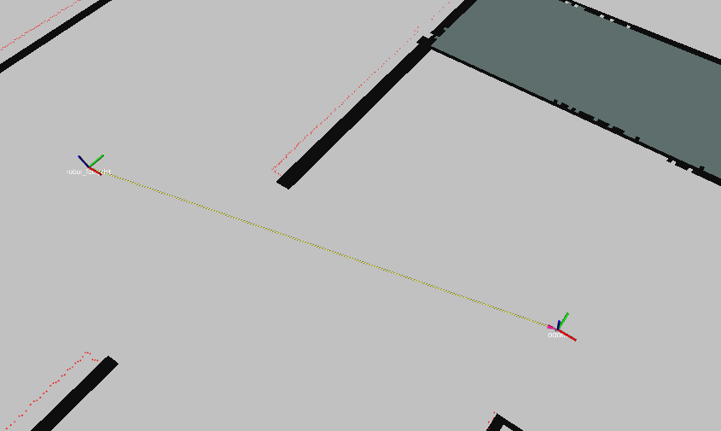
Mapping | GMapping Algorithm
4
Mapping &
Navigation
Odometry
It is the process of estimating a robot’s position and orientation over time motion sensors such as wheel encoders.
1
Introduction
2
Application
3
Ros &
Kinematics
5
Person
Tracking
6
Product
Recognition
7
Wireless
Comm
CONTENT

Slide 31
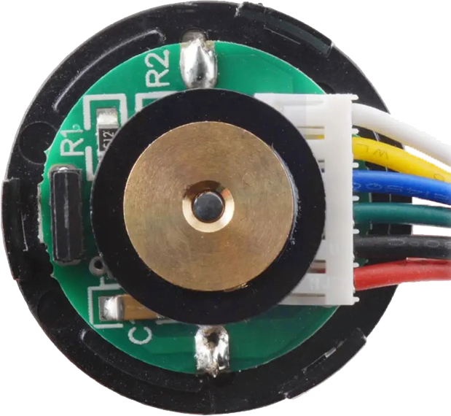
Mapping | GMapping Algorithm
4
Mapping &
Navigation
Encoders
Motor Encoders are sensors to the motors that measure rotation of the motor shaft.
We use magnetic encoder.
Encoders generate pulses as the motor shaft rotate.
By counting this pulses these pulses, we can calculate:
Distance traveled by the wheel.
Speed of rotation.
Direction(clockwise or anticlockwise).
1
Introduction
2
Application
3
Ros &
Kinematics
5
Person
Tracking
6
Product
Recognition
7
Wireless
Comm
CONTENT

Slide 32
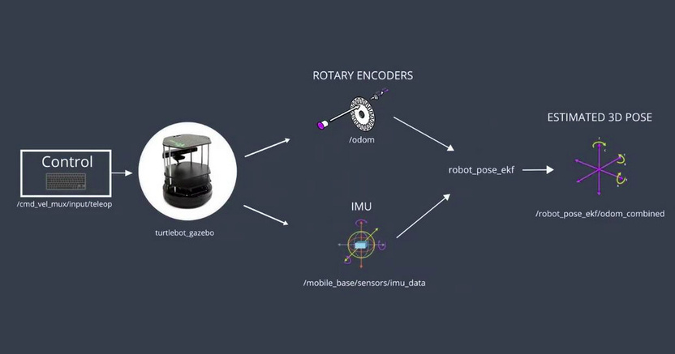
Mapping | GMapping Algorithm
4
Mapping &
Navigation
Challenges
Bad odometry and inaccurate localization.
Solution
1
Introduction
2
Application
3
Ros &
Kinematics
5
Person
Tracking
6
Product
Recognition
7
Wireless
Comm
CONTENT
“Inertial Measurement Unit” IMU sensors typically consist of a combination of accelerometers, gyroscopes, and sometimes magnetometers, (IMU) sensor in robotics is to provide information about an object's orientation and motion by measuring its linear accelerations and angular velocities. This information is useful for tasks such as navigation, localization, and mapping.
We combined wheel encoders with IMU to improve odometry accuracy. Encoders provide distance, while IMU refines orientation and detects slipping. Together, they enable more reliable localization.

Slide 33
Mapping | GMapping Algorithm
4
Mapping &
Navigation
Challenges
No Lidar Only Kinect.
Convert depth image to laser scan.
1
Introduction
2
Application
3
Ros &
Kinematics
5
Person
Tracking
6
Product
Recognition
7
Wireless
Comm
CONTENT

Slide 34
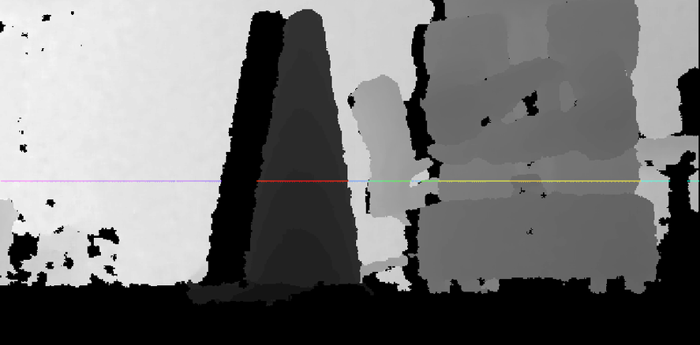
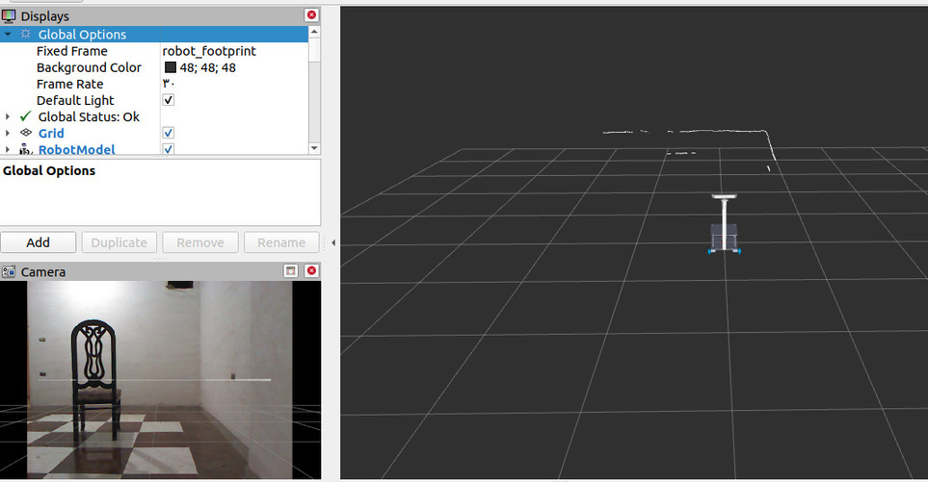
Mapping | GMapping Algorithm
4
Mapping &
Navigation
Solution
To overcome this, we used the depthimage_to_laserscan Ros package.
It converts the Kinect’s depth data into a virtual laser scan.
1
Introduction
2
Application
3
Ros &
Kinematics
5
Person
Tracking
6
Product
Recognition
7
Wireless
Comm
CONTENT

Slide 35
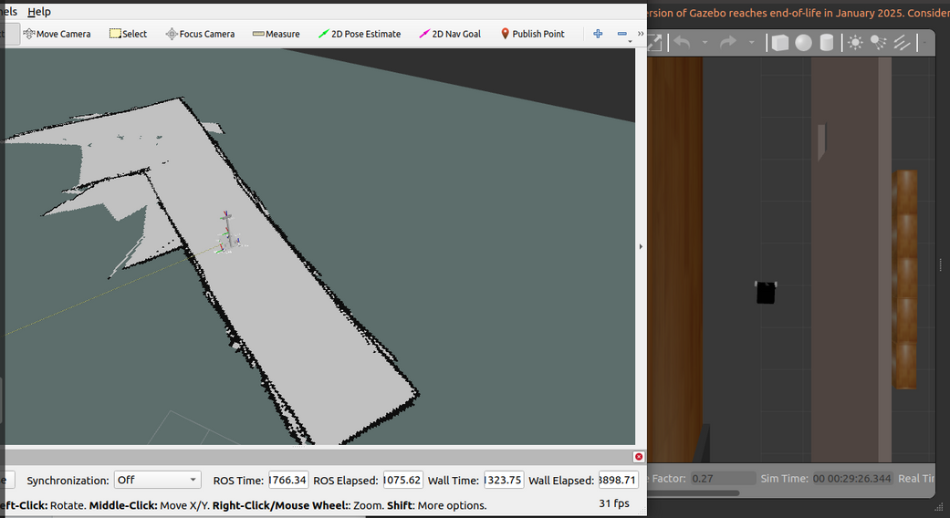
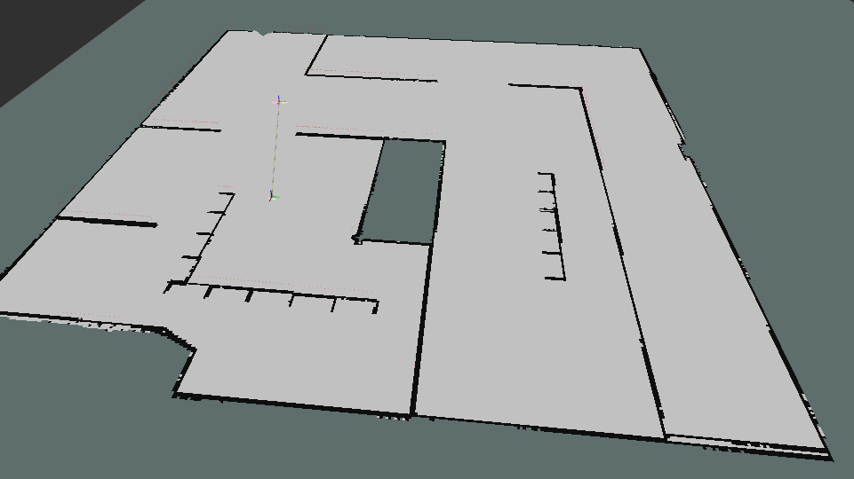
Mapping | GMapping Algorithm
4
Mapping &
Navigation
Simulation Scenes
1
Introduction
2
Application
3
Ros &
Kinematics
5
Person
Tracking
6
Product
Recognition
7
Wireless
Comm
CONTENT

Slide 36

Mapping | GMapping Algorithm
4
Mapping &
Navigation
Practical Video
1
Introduction
2
Application
3
Ros &
Kinematics
5
Person
Tracking
6
Product
Recognition
7
Wireless
Comm
CONTENT

Slide 37
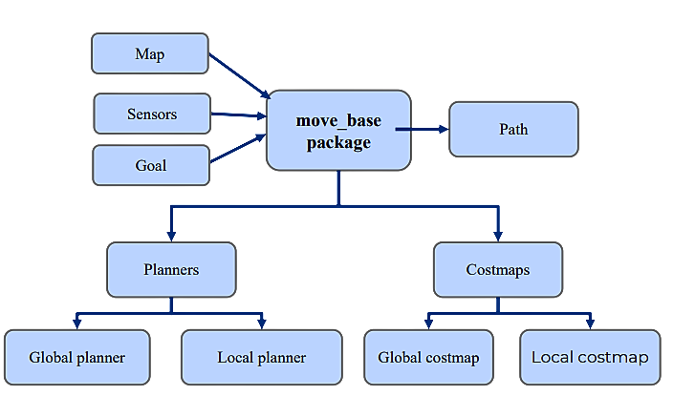
Navigation & path planning to Parking Spot
4
Mapping &
Navigation
Move_base
1
Introduction
2
Application
3
Ros &
Kinematics
5
Person
Tracking
6
Product
Recognition
7
Wireless
Comm
CONTENT

Slide 38
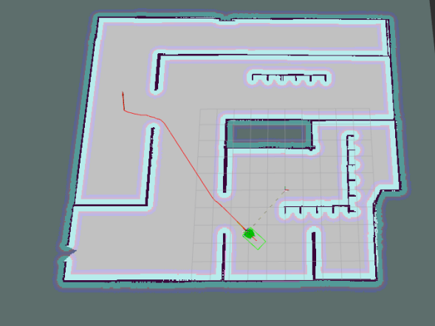
Navigation & path planning to Parking Spot
4
Mapping &
Navigation
Global Planner
Create a global path that depends on the map.
Type of planner A* algorithm.
1
Introduction
2
Application
3
Ros &
Kinematics
5
Person
Tracking
6
Product
Recognition
7
Wireless
Comm
CONTENT

Slide 39
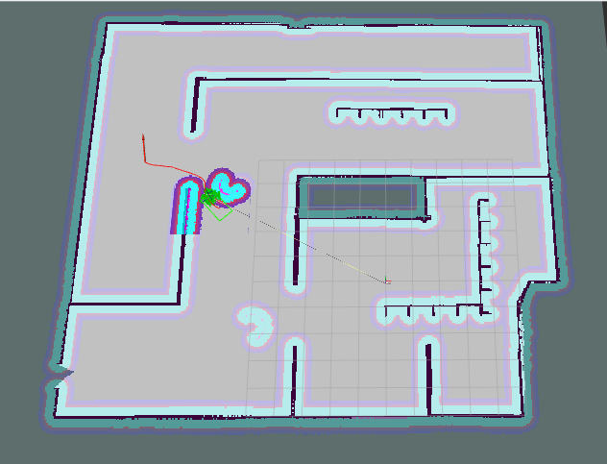
Navigation & path planning to Parking Spot
4
Mapping &
Navigation
Local Planner
represent the immediate surroundings of the robot. It
generating a trajectory that guides the robot from its current position to the next point on the global path. The loca planner takes into account dynamic obstacles. It operates on local costmap.
DWA algorithm(Dynamic Window Approach)
Set margin around the dynamic obstacles
1
Introduction
2
Application
3
Ros &
Kinematics
5
Person
Tracking
6
Product
Recognition
7
Wireless
Comm
CONTENT

Slide 40
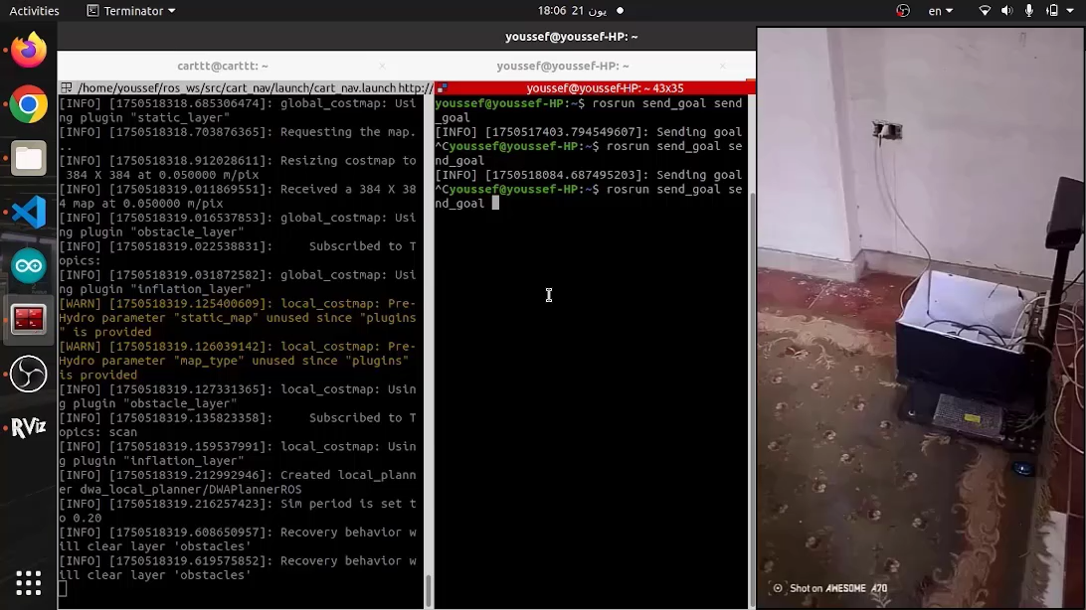
Navigation & path planning to Parking Spot
4
Mapping &
Navigation
Obstacle Avoidance
1
Introduction
2
Application
3
Ros &
Kinematics
5
Person
Tracking
6
Product
Recognition
7
Wireless
Comm
CONTENT

Slide 41
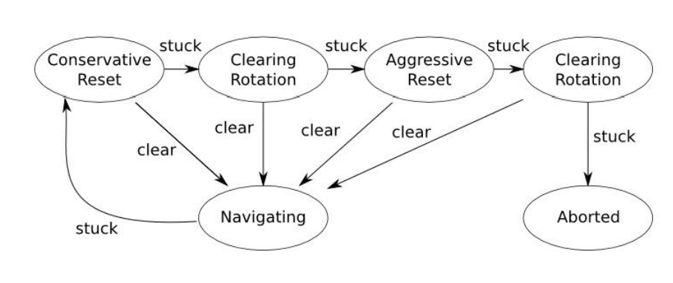
Navigation & path planning to Parking Spot
4
Mapping &
Navigation
Challenge
The Robot Stuck!
Solution
1
Introduction
2
Application
3
Ros &
Kinematics
5
Person
Tracking
6
Product
Recognition
7
Wireless
Comm
CONTENT
Recovery Behavior

Slide 42

Navigation & path planning to Parking Spot
4
Mapping &
Navigation
Practical Video
1
Introduction
2
Application
3
Ros &
Kinematics
5
Person
Tracking
6
Product
Recognition
7
Wireless
Comm
CONTENT

Slide 43
1
Introduction
2
Application
3
Ros &
Kinematics
4
Mapping &
Navigation
5
Person
Tracking
6
Product
Recognition
7
Wireless
Comm
CONTENT

Slide 44
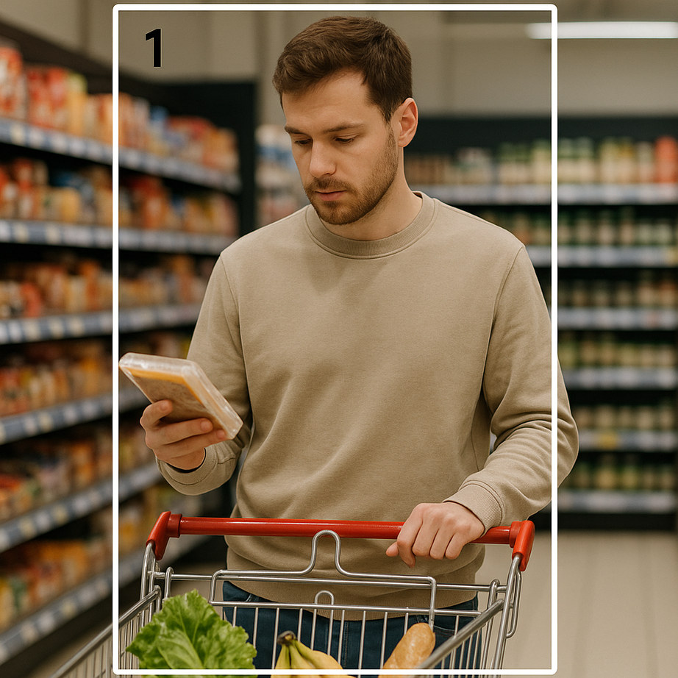
Person Tracking
5
Person
Tracking
Objectives
Detection: Camera detects all persons in the FOV & assign each one with a specific ID.
1
Introduction
2
Application
3
Ros &
Kinematics
4
Mapping &
Navigation
6
Product
Recognition
7
Wireless
Comm
CONTENT
Select target: The target to be tracked selects his ID.
Accurate Following: Follow the target accurately through dynamic environments.
Re-Identification: Re-identify the user if they temporarily disappear.

Slide 45
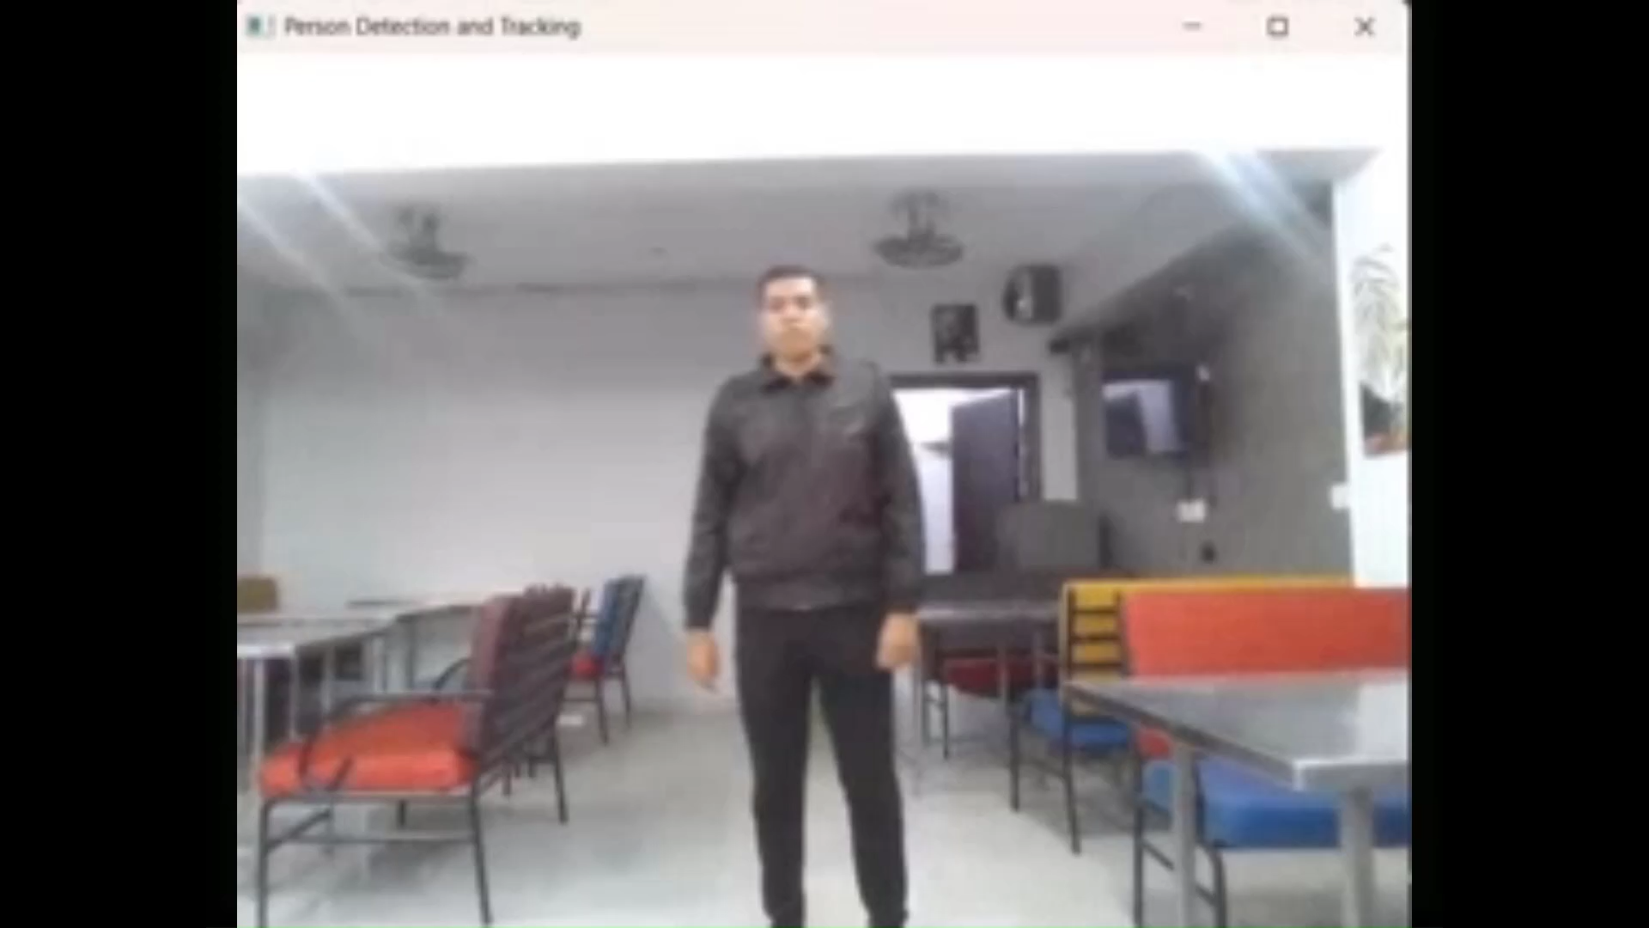
Person Tracking
5
Person
Tracking
Initial Algorithm Tools
YOLO: For person detection & assigning an ID to the 1st person showed in front of camera FOV.
1
Introduction
2
Application
3
Ros &
Kinematics
4
Mapping &
Navigation
6
Product
Recognition
7
Wireless
Comm
CONTENT
IOU: For bounding box similarity.
Euclidean Distance (Centroid): For motion tracking.
KMeans: For Re-Identification by clustering dominant clothing color.

Slide 46
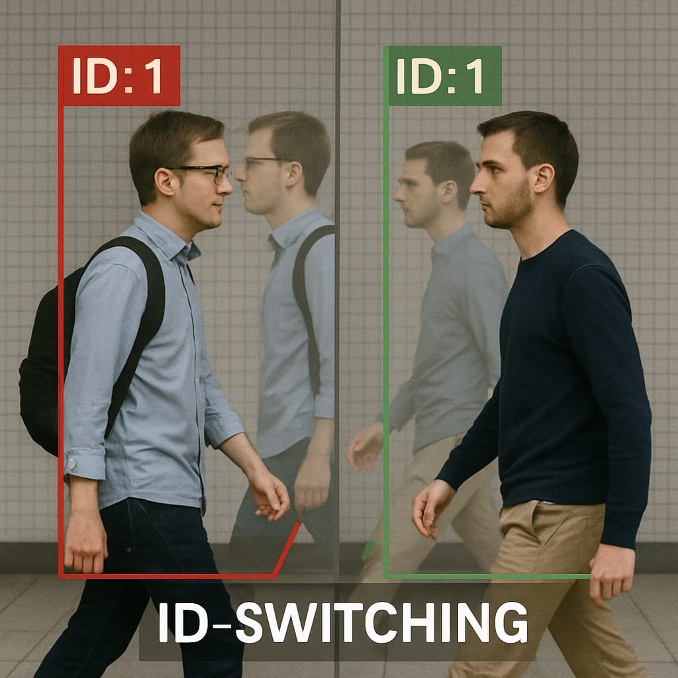

Person Tracking
5
Person
Tracking
Testing and Challenges
Exit/Entry Errors
Incorrectly associated new persons entering the scene with the original target, causing tracking errors.
1
Introduction
2
Application
3
Ros &
Kinematics
4
Mapping &
Navigation
6
Product
Recognition
7
Wireless
Comm
CONTENT
Occlusion Issue:
Failed to maintain tracking when the target was occluded, leading to incorrect identification of other individuals (ID swapping).

Slide 47

Person Tracking
5
Person
Tracking
Final Algorithm Tools
YOLO: For person detection & assigning a unique ID to all detected persons.
1
Introduction
2
Application
3
Ros &
Kinematics
4
Mapping &
Navigation
Deep SORT: (Simple Online and Realtime Tracking) is an algorithm used for multi-object tracking in video streams.
6
Product
Recognition
7
Wireless
Comm
CONTENT
Kalman Filter: For state prediction. The state of an object typically includes its position, velocity, and acceleration. The Kalman filter predicts the state of each object in the current frame based on its last known state, accounting for the object's motion dynamics.
OSNet_ain_x1_0: Used for Re-Identification of target being tracked.

Slide 48

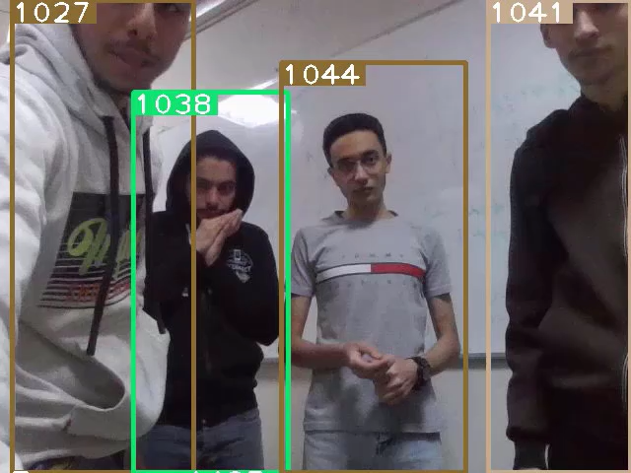
Person Tracking
5
Person
Tracking
Test Cases & Results
Target Re-Identification with Interference
1
Introduction
2
Application
3
Ros &
Kinematics
4
Mapping &
Navigation
Target Leaves While a Distractor Remains
6
Product
Recognition
7
Wireless
Comm
CONTENT
Crowded Environment and Back-Facing Target
Overall, the tracking system demonstrated high reliability, minimal identity switches, and strong re-identification performance in complex scenarios.

Slide 49
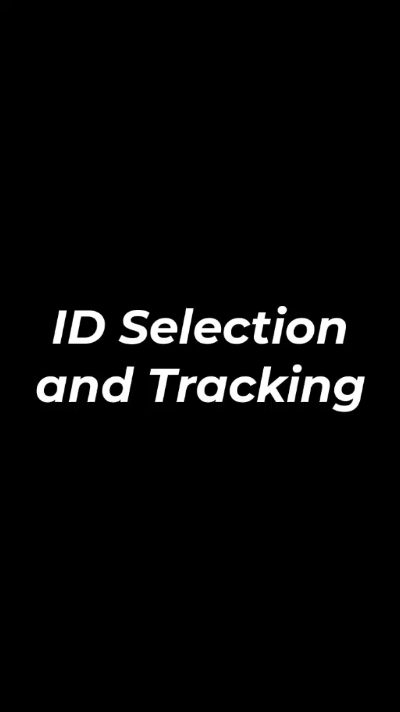
Person Tracking
5
Person
Tracking
Integration
1
Introduction
2
Application
3
Ros &
Kinematics
4
Mapping &
Navigation
6
Product
Recognition
7
Wireless
Comm
CONTENT

Slide 50
1
Introduction
2
Application
3
Ros &
Kinematics
4
Mapping &
Navigation
5
Person
Tracking
6
Product
Recognition
7
Wireless
Comm
CONTENT

Slide 51
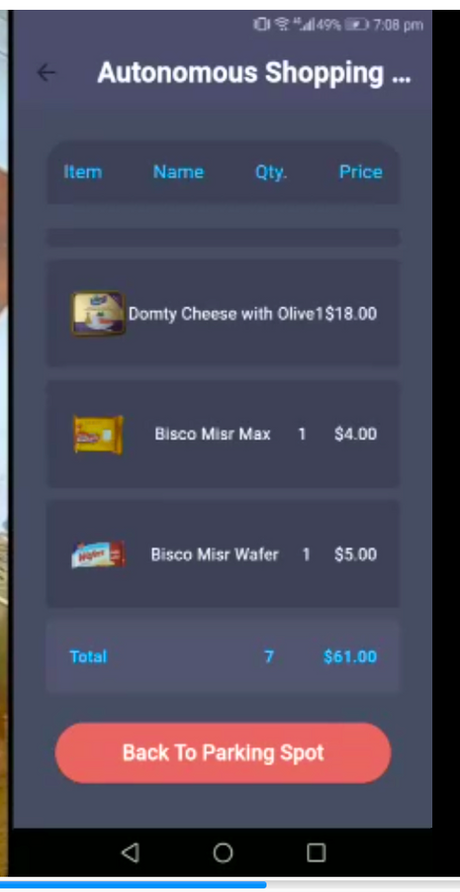
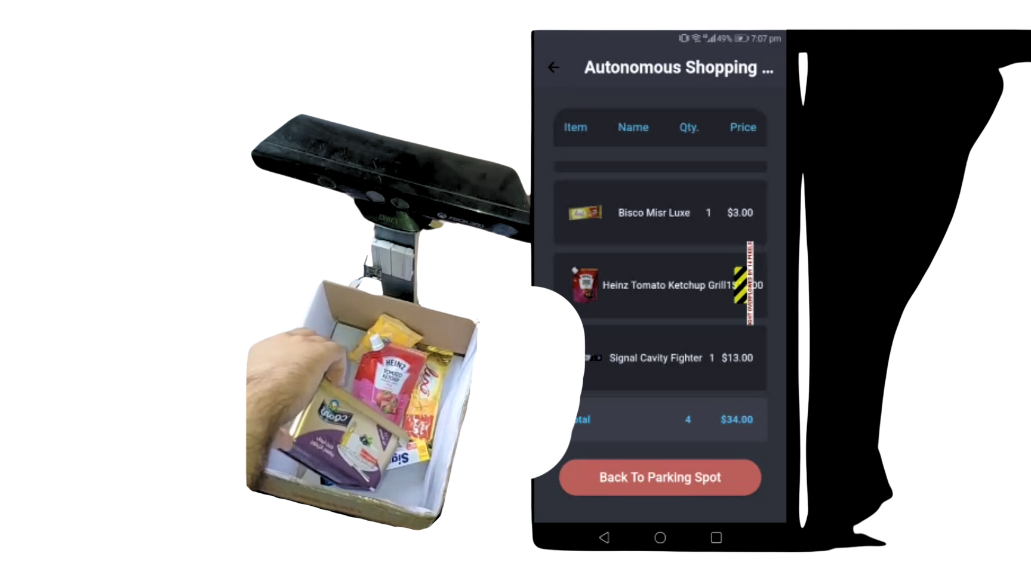
Product Recognition
6
Product
Recognition
Overview
Product Recognition is a feature that uses Computer Vision to identifies any product added to the cart by the user, saving its characteristics such as image, name, price, and quantity. These information are displayed on the Mobile Application.
This feature includes real-time updates of the cart’s contents, whether products are added or removed.
It allows the user to know exactly what is in their cart and which products they still need to add.
Let’s dive deep!
1
Introduction
2
Application
3
Ros &
Kinematics
4
Mapping &
Navigation
5
Person
Tracking
7
Wireless
Comm
CONTENT

Slide 52
Product Recognition
6
Product
Recognition
Dataset
Previously, two open-source datasets were used for training but could not be further utilized due to the following limitations:
1
Introduction
2
Application
3
Ros &
Kinematics
4
Mapping &
Navigation
5
Person
Tracking
7
Wireless
Comm
CONTENT
Grocery Store Dataset
Biscuit Wrappers Dataset
Class imbalance. (Small number of images per class.)
Quality issues for some images (blur).
Products are not available in Egyptian markets
Few number of orientations per product

Slide 53
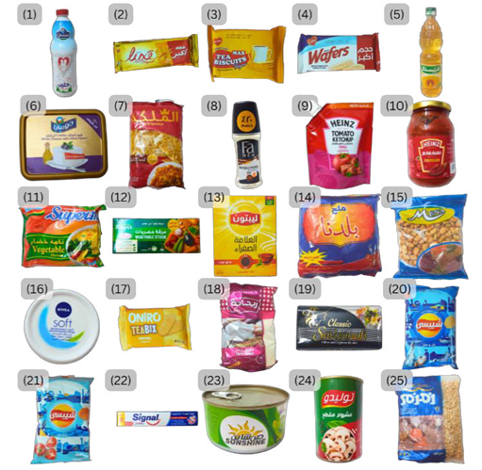
Product Recognition
6
Product
Recognition
Dataset
As a result, a custom dataset was made from scratch, representing 25 common consumer products found in Egyptian supermarkets and grocery stores.
1
Introduction
2
Application
3
Ros &
Kinematics
4
Mapping &
Navigation
5
Person
Tracking
7
Wireless
Comm
CONTENT
1 Beyti Full Cream Milk 900mL | 2 Bisco Misr Luxe | 3 Bisco Misr Max | 4 Bisco Misr Wafer | 5 Crystal Sunflower Oil - 800mL
6 Domty Cheese with Olive | 7 El Maleka Elbow Pasta - 400G | 8 Fa Men Anti-perspirant Roll-on | 9 Heinz Tomato Ketchup Grill | 10 Heinz Tomato Paste
11 Indomie Supermi Vegetable | 12 Knorr Vegetable Stock - 12 Cubes | 13 Lipton Yellow Label Tea Dust 40g | 14 Malh Baladna Salt - 300g | 15 Mena Foul Fava Beans
16 Nivea Soft Moisturizing Cream | 17 Oniro Teabix Biscuits | 18 Rehana Flour 1Kg | 19 Savannah Classic Soap - 125g | 20 Shepsy Salt and Vinegar Chips
21 Shepsy Tomato Chips | 22 Signal Cavity Fighter | 23 Sunshine Shredded Tuna | 24 Toledo Mushroom | 25 Zam Zam Black Eye Beans 500g

Slide 54

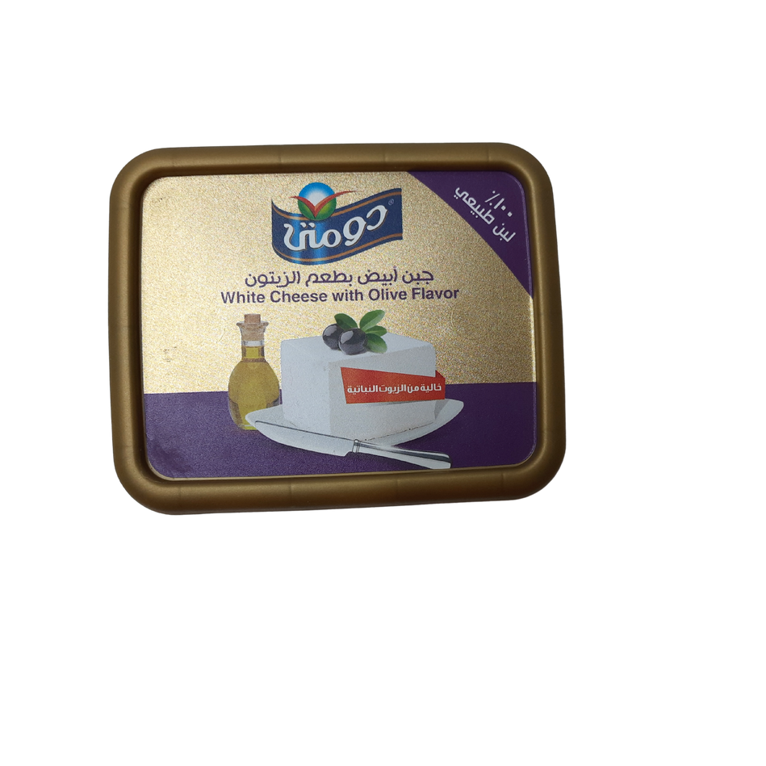
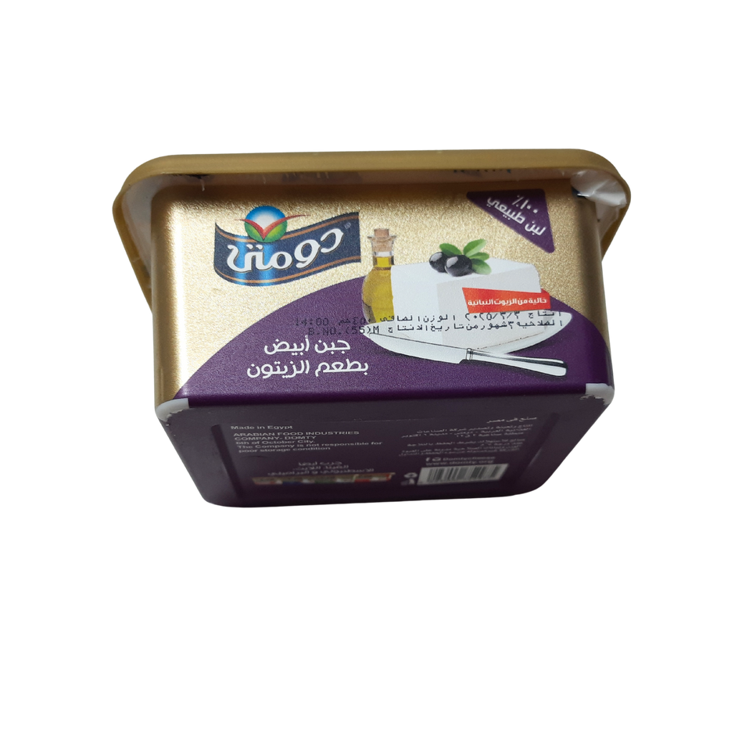
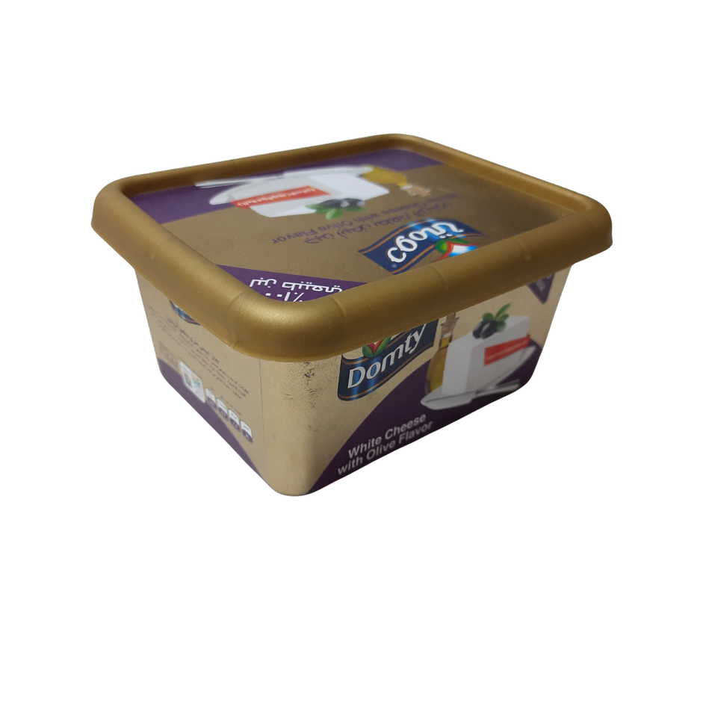
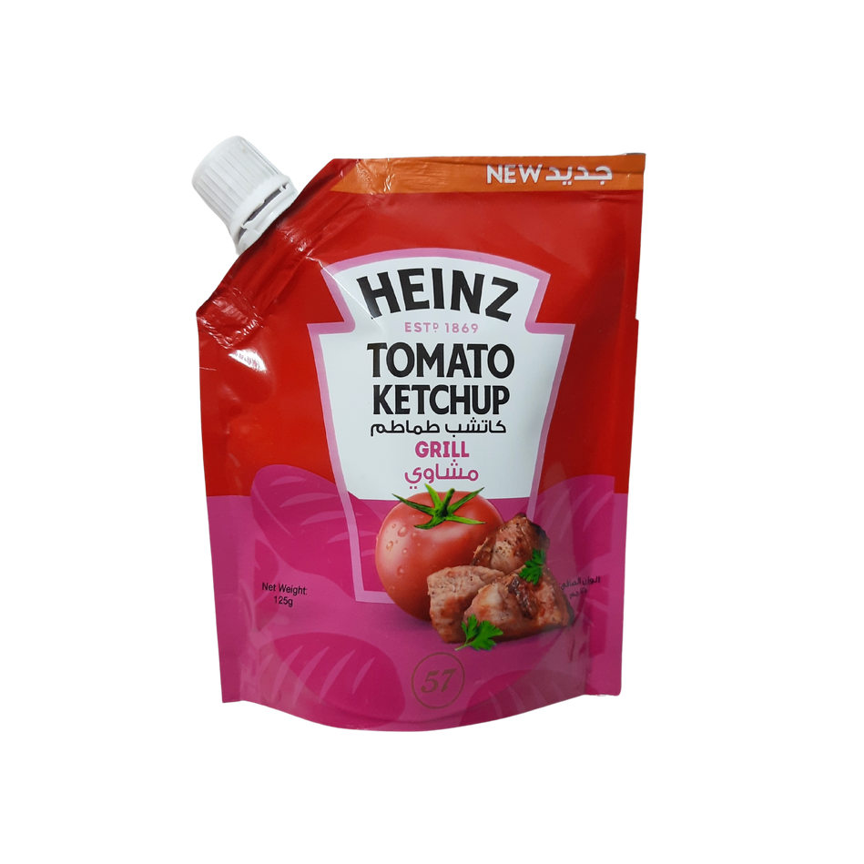
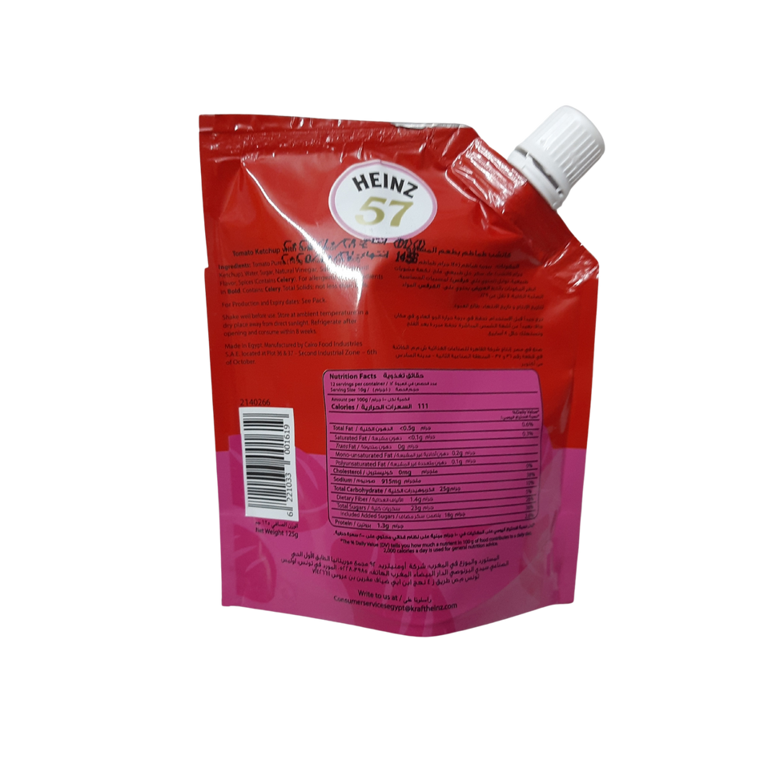
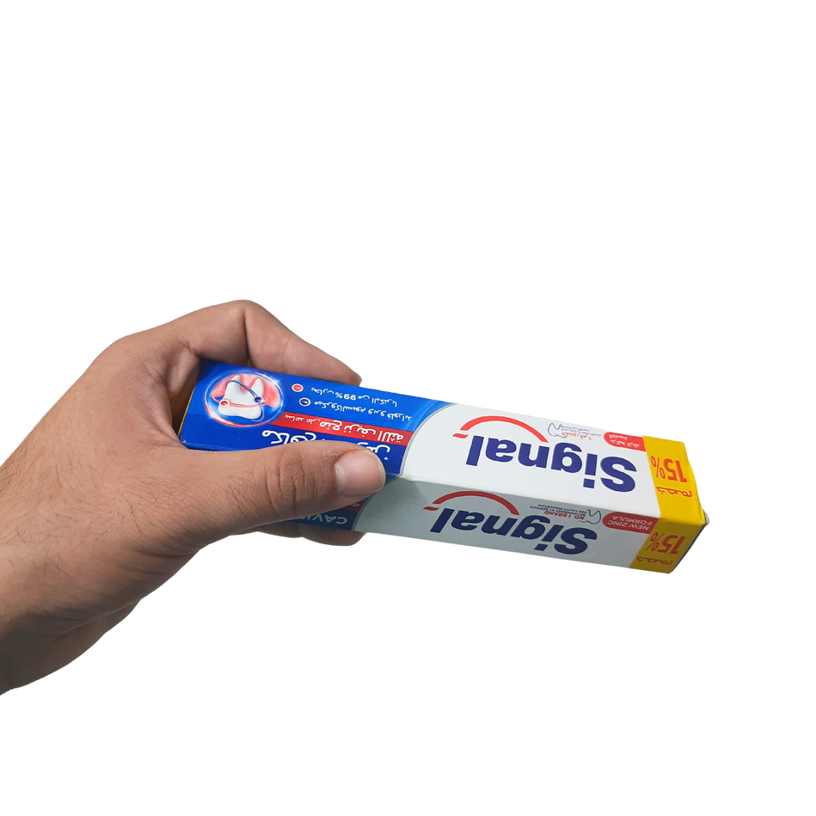

Product Recognition
6
Product
Recognition
Perspective
Full view, edge views, and corner views
Capturing Guidelines
1
Introduction
2
Application
3
Ros &
Kinematics
4
Mapping &
Navigation
5
Person
Tracking
7
Wireless
Comm
CONTENT
Sides
Both front and back of the product
View Type
Self-standing ( without occlusion) and Handheld (with occlusion)

Slide 55
Product Recognition
6
Product
Recognition
Dataset
It comprises 25 distinct classes.
The number of raw images captured before augmentation = 985 images.
The number of final images captured after augmentation = 4,828 images.
Splitting ratio:
Training set 85%: 4093 images.
Validation set 15%: 735 images.
Fixed random seed of 42.
1
Introduction
2
Application
3
Ros &
Kinematics
4
Mapping &
Navigation
5
Person
Tracking
7
Wireless
Comm
CONTENT

Slide 56







Product Recognition
6
Product
Recognition
2. Extend
Prevent out-of-boundary issues, Prevent negative coordinates during rotation, new formula was made:
1
Introduction
2
Application
3
Ros &
Kinematics
4
Mapping &
Navigation
5
Person
Tracking
7
Wireless
Comm
CONTENT
1. Crop
square 1:1 aspect ratio
3. Resize
reduce the overall dataset size, and match the model’s required input dimensions of 640 pixels
Preprocessing
4.Annotate
Oriented Bounding Boxes (OBB) was used for a tighter fit, manually drawn using Roboflow’s platform

Slide 57









Product Recognition
6
Product
Recognition
Translate = 0.1
Rotation:
statically by 0° (original), 90°, 180°, and 270°.
dynamically slight rotation from -40° to +40°, however limited to 40° to prevent duplication
Shifts images horizontally and vertically by a random fraction of the image size.
1
Introduction
2
Application
3
Ros &
Kinematics
4
Mapping &
Navigation
5
Person
Tracking
7
Wireless
Comm
CONTENT
Scale = 0.5
Enables models to handle objects at different distances and sizes.
Augmentation
Blurring
Automatically done by Albumentations during training.
Coloring
lighting conditions can affect object appearance
hsv_h = 0.015: Hue shifts image colors slightly.
hsv_s = 0.3: Saturation modifies the intensity of colors img.
hsv_v = 0.3: Value changes the brightness of the image.

Slide 58
Product Recognition
6
Product
Recognition
Model
CV Classification phase:
First, we tried different classification only models searching for the balance between speed and highest accuracy.
using IR sensors for detection.
complicated, expensive and not an accurate event detection method (add/remove).
Classification Models | Accuracy (%)
ResNet50V2 | 94.7
ResNet101V2 | 94.4
VGG16 | 76
VGG19 | 71
Inception | 92
MobileNetV3Small | 3
MobileNetV2 | 98.7
1
Introduction
2
Application
3
Ros &
Kinematics
4
Mapping &
Navigation
5
Person
Tracking
7
Wireless
Comm
CONTENT

Slide 59

Product Recognition
6
Product
Recognition
Model
CV Detection phase:
We used YOLOv8-OBB for both detection and classification.
It offered the best balance between speed and accuracy.
Training on Google Colab using Tesla T4 GPU:
is done over 50 epochs.
using a 640×640 image size.
with the AdamW optimizer.
batch size of 16.
The final architecture comprised 144 layers.
1
Introduction
2
Application
3
Ros &
Kinematics
4
Mapping &
Navigation
5
Person
Tracking
7
Wireless
Comm
CONTENT

Slide 60

Product Recognition
6
Product
Recognition
Deployment
Developing Visualizers:
Webcam.
Draw OBB, boundary line, counter.
Trackbar.
Log file.
1
Introduction
2
Application
3
Ros &
Kinematics
4
Mapping &
Navigation
5
Person
Tracking
7
Wireless
Comm
CONTENT

Slide 61

Product Recognition
6
Product
Recognition
Deployment
Extracted: Bounding box coordinates, confidence score, class name and tracking id.
Smoothing Bbox through frames (webcam).
Counting Logic:
The product is considered added to the cart, if a product position is before the boundary and in the next frame the position is after the boundary threshold line.
The product is considered removed to the cart, if a product position is after the boundary and in the next frame the position is before the boundary.
Message Preparing: that includes the product ID, name, quantity (+1 or -1), and price is prepared and sent to the app.
Error Handling: Transient detection failures using a “no_detection_counter” to reset state if no product is found. Object ID duration tracking to ignore unstable or brief detections (debouncing).
1
Introduction
2
Application
3
Ros &
Kinematics
4
Mapping &
Navigation
5
Person
Tracking
7
Wireless
Comm
CONTENT

Slide 62


Product Recognition
6
Product
Recognition
Deployment
All 25 Products on Webcam
1
Introduction
2
Application
3
Ros &
Kinematics
4
Mapping &
Navigation
5
Person
Tracking
7
Wireless
Comm
CONTENT

Slide 63
1
Introduction
2
Application
3
Ros &
Kinematics
4
Mapping &
Navigation
5
Person
Tracking
6
Product
Recognition
7
Wireless
Comm
CONTENT

Slide 64

Wireless Communication & IoT
7
Wireless
Comm
System Architecture
Arduino Mega: Low-level controller for motors via motor driver, encoders, and IMU.
Raspberry Pi 3B: Interfaces with Kinect, acts as ROS node, connects to Arduino via rosserial.
External PC with GPU: Runs ROS Master, AI models, mapping and navigation .
ESP32-CAM: Captures product video, sends to PC via WebSocket.
Mobile App: MQTT/WebSocket client for user interaction.
Access Point (Wi-Fi): Creates a local network connecting all devices together.
1
Introduction
2
Application
3
Ros &
Kinematics
4
Mapping &
Navigation
5
Person
Tracking
6
Product
Recognition
CONTENT

Slide 65

Wireless Communication & IoT
7
Wireless
Comm
System Network Overview
A dedicated Wi-Fi Access Point provides a closed Local Area Network (LAN) for all devices involved in the system. This LAN ensures secure, low-latency, and internet-independent Communication between the system components.
1
Introduction
2
Application
3
Ros &
Kinematics
4
Mapping &
Navigation
5
Person
Tracking
6
Product
Recognition
CONTENT

Slide 66
Wireless Communication & IoT
7
Wireless
Comm
IP Configuration
To ensure reliable identification and routing, static IPs were assigned to the PC, Raspberry Pi, and ESP32-CAM in each cart. The PC requires a static IP as it hosts the ROS Master, WebSocket server, and MQTT broker. For each autonomous cart, the Raspberry Pi and ESP32-CAM were also given fixed IPs to allow the PC to uniquely distinguish between multiple carts, and to properly route tracking, product streams, and control messages. In contrast, the mobile app connects dynamically using a DHCP-assigned IP, allowing any user device to access the system without manual configuration.
This setup ensures:
Stable routing for ROS nodes.
Easy access for any mobile device.
1
Introduction
2
Application
3
Ros &
Kinematics
4
Mapping &
Navigation
5
Person
Tracking
6
Product
Recognition
CONTENT

Slide 67
Wireless Communication & IoT
7
Wireless
Comm
Communication Protocols Overview
To establish reliable and real-time Communication between the various components of the autonomous shopping cart, we used a combination of protocols, including both IoT and non-IoT standards:
MQTT (IoT Messaging).
WebSocket (Streaming + Event Communication).
TCPROS (ROS native Communication).
Bridging techniques to connect ROS with non-ROS components.
1
Introduction
2
Application
3
Ros &
Kinematics
4
Mapping &
Navigation
5
Person
Tracking
6
Product
Recognition
CONTENT

Slide 68

Wireless Communication & IoT
7
Wireless
Comm
MQTT Protocol
Type: IoT messaging protocol (publish-subscribe).
Advantages: Efficient, Lightweight and Asynchronous messaging.
The Mosquitto MQTT broker is hosted on the PC.
Mobile App ↔ ROS Nodes
Start Button Sends a command to initiate and start the entire system operation.
Parking Button Sends a parking request to the ROS navigation node to stop or return the cart.
Person ID Input Allows the user to enter a person ID, which is sent to the tracking node to follow the selected person.
Mobile App ↔ Product Recognition Node
Product Table Displays product names and details received from the product recognition AI model via MQTT.
1
Introduction
2
Application
3
Ros &
Kinematics
4
Mapping &
Navigation
5
Person
Tracking
6
Product
Recognition
CONTENT

Slide 69


Wireless Communication & IoT
7
Wireless
Comm
WEbSocket Protocol
Type: Full-duplex, persistent connection over TCP.
Advantages: Fast, real-time updates, Works well for streaming media and Compatible with browsers & mobile apps.
ESP32-CAM → PC
ESP32-CAM acts as a WebSocket client that streams video frames to the PC WebSocket server.
PC uses a non-ROS Product Recognition module to detect and classify items.
PC → Mobile App
PC streams tracking video to the app for live monitoring.
App receives frames over WebSocket.
1
Introduction
2
Application
3
Ros &
Kinematics
4
Mapping &
Navigation
5
Person
Tracking
6
Product
Recognition
CONTENT

Slide 70

Wireless Communication & IoT
7
Wireless
Comm
TCPROS Protocol
Type: ROS-specific protocol over TCP.
Advantages: Handles publishing/subscribing between ROS nodes, Efficient within ROS architecture and Supports distributed systems.
Registration:
Master shares connection info (IP, Port).
Node tells Master what topics/services it offers or needs.
Communication:
Nodes talk directly to each other.
Fast real-time message passing.
1
Introduction
2
Application
3
Ros &
Kinematics
4
Mapping &
Navigation
5
Person
Tracking
6
Product
Recognition
CONTENT
ROS Master-Node Communication PC ↔ Raspberry Pi

Slide 71

Wireless Communication & IoT
7
Wireless
Comm
ROS-to-Non-ROS Communication Bridges
The ROS Bridges are used to enable seamless Communication between ROS-based systems and external non-ROS application. Since ROS natively communicates within its own ecosystem using topics and services, it cannot directly interact with devices or services outside of ROS. This approach makes robotic systems more flexible, scalable, and accessible for broader integration.
MQTT Bridges: To allow non-ROS mobile app to interact with ROS navigation and Person Tracking nodes.
WebSocket Bridges: To stream video from the ROS-based Person Tracking node to the mobile app.
1
Introduction
2
Application
3
Ros &
Kinematics
4
Mapping &
Navigation
5
Person
Tracking
6
Product
Recognition
CONTENT

Slide 72
Conclusion
Interactive mobile App
Creating 2D map
Navigation to parking spot
Recognition of 25 products and they are added or removed while displaying them on the app
Reliable tracking to individual user
1
Introduction
2
Application
3
Ros &
Kinematics
4
Mapping &
Navigation
5
Person
Tracking
6
Product
Recognition
7
Wireless
Comm
CONTENT

Slide 73
Future Work
THANK
Using multiple cameras to do inference from different positions at the same time.
Using LIDAR.
Using more powerful central GPU or local jetson nano/google coral.
Raspberry Pi Camera Module 3, 12MP.
Payment system.
1
Introduction
2
Application
3
Ros &
Kinematics
4
Mapping &
Navigation
5
Person
Tracking
6
Product
Recognition
7
Wireless
Comm
CONTENT
YOU
Not just a Shopping Cart.

Slide 74
THANK
YOU

